Slide 1
Attack Surface
James Walden
Northern Kentucky University

Slide 2
Topics
Attack Surface
Attack Surface Reduction
Measuring Attack Surface
Web Application Attack Surface
AJAX Attack Surface

Slide 3
Attack Surface
Attack surface: the set of ways an application can be attacked.
Used to measure attackability of app.
  The larger the attack surface of a system, the more likely an attacker is to exploit its vulnerabilities and the more damage is likely to result from attack.
  Compare to measuring vulnerability by counting number of reported security bugs.
  Both are useful measures of security, but have very different meanings.

Slide 4
Why Attack Surface Reduction?
If your code is perfect, why worry?
  All code has a nonzero probability of containing vulnerabilities.
  Even if code is perfect now, new vulns arise.
    Format string vulnerability was discovered in 1999.
    A particular application was immune to XML injection until you added an XML storage feature.
Allows focus on more dangerous code.
  ASR eliminates unnecessary exposures.
  Allows focus on required exposures.

Slide 5
Attack Surface Reduction
Reduce code that executes by default.
Restrict who can access the code.
Reduce privilege level of code.

Slide 6
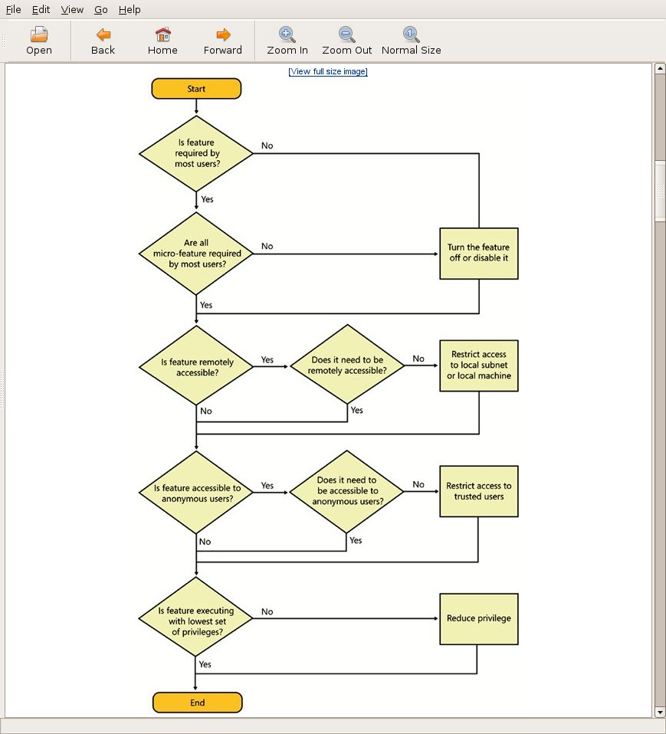
Code Reduction
IIS Example
Feature Level
  IIS5 default in W2k
  IIS6 not in W2k3
Micro-Feature
  IIS6 static only by default.
Notes:
Figure 7.1 from The Security Development Lifecycle

Slide 7
Reducing Who Can Access
User Level Access
  Anonymous
  Authenticated User
  Administrator
Network Access
  Local PC Only
  Restricted Network
    Limited to some IPs
  Remote Access
Remote
Restricted
Increasing Attack Surface
Local
Admin
Auth
User
Anon

Slide 8
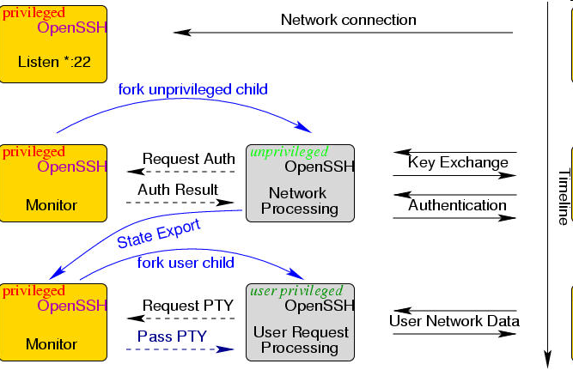
Reduce Privilege
Remove Admin
  Many programs don’t need admin.
  Change file ACLs so program can use.
Privilege Separation
  Divide software into root and non-root processes by function.
  SSH needs root for
    Open port 25.
    Switch UID on login.
Privilege Separated OpenSSH
Notes:
Image from http://www.citi.umich.edu/u/provos/ssh/privsep.html

Slide 9
Relative Attack Surface Rankings
Higher Attack Surface | Lower Attack Surface
Feature runs by default. | Feature doesn’t run by default.
Open network connection. | Closed network connection.
Listening for UDP and TCP. | Listening for TCP only.
Anonymous access. | Authenticated access only.
Internet access. | Subnet, link-local, or site-local network access.
Subnet, link-local, or site-local network access. | Local machine access.
Code running as Admin/root. | Code running in low priv account.
Broad ACLs. | Strict ACLs.
Many URLs are entry points. | Only one/few URLs are entry points.

Slide 10
Measuring Attack Surface
Sum of resources that make up surface.
Advantages
  Easy to compute.
  Categories can be measured independently.
Disadvantages
  Counts root access equal to anon access.
  Ignores interactions among resources.

Slide 11
Damage-Potential Effort Ratio
Damage Potential is
  Resources * (Item Privilege/Access Required)
Resource Types
  Methods: entry points and exit points.
  Channels: ports, RPCs, web services.
  Data Items: files, db entries.
Attack Surface defined as triple
  (Method der, Channel der, Data Item der)

Slide 12
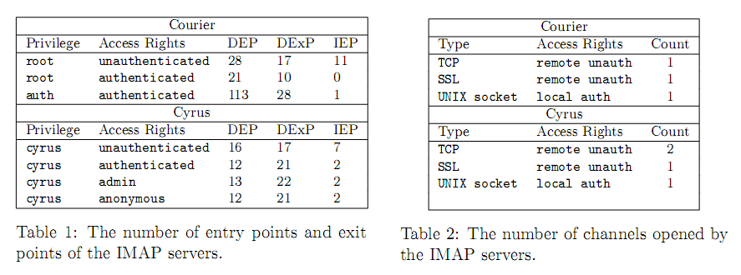
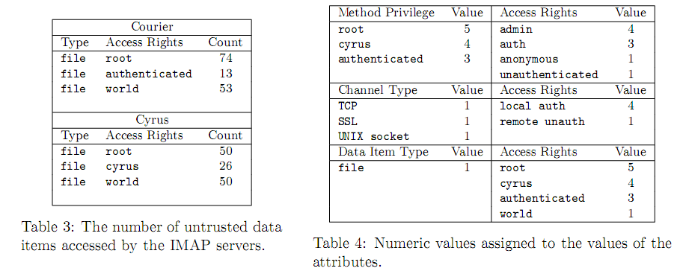
IMAP Server Comparison
Courier IMAP
  <522.00, 2.25, 72.13>
Cyrus
  <383.60,3.25,66.50>
Courier Computation Details
Methods:
56 x 5 + 31 x (5/3) + 142 x (3/3)
Channels:
1 x 1 + 1 x 1 + 1 x (1/4)
Data Items:
74 x (1/5) + 13 x (1/3) + 53 x 1
Example from TR: CMU-CS-07-146

Slide 13


Traditional Web Applications
HTTP Request (form submission)‏
User waits
Server processing
HTTP Response (new web page)‏
User interaction
HTTP Request (form submission)‏
User waits
Server processing
HTTP Response (new web page)‏

Slide 14
Web Methods, Channels, and Data
Methods
  URL paths
  URL action parameters
Channels
  Port 80
  Port 443 SSL
  Web Services
Data Items
  Cookies
  Other client-side storage
  Server files
  Database

Slide 15
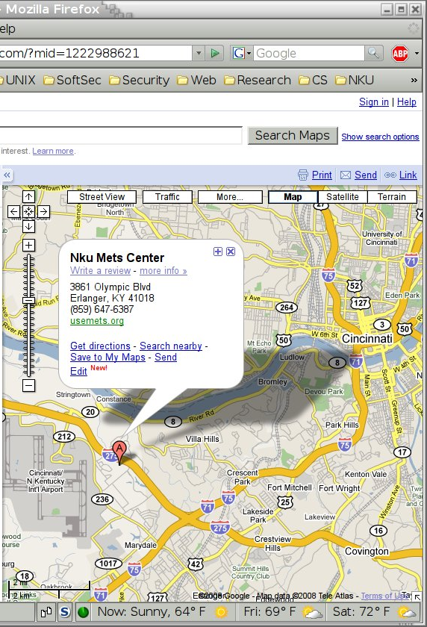
AJAX
Asynchronous Javascript and XML
  User interacts with client-side Javascript.
  Javascript makes asynchronous requests to server for data.
  Continues to allow user to interact with application.
  Updates when receives encoded data from server.

Slide 16
AJAX Applications
Client-side
Code
HTTP request (asynchronous)‏
User interaction
HTTP Response (data)‏
Server processing
partial update
User interaction
partial update
HTTP request (asynchronous)‏
HTTP Response (data)‏
Server processing
User interaction
HTTP request (asynchronous)‏
HTTP Response (data)‏
partial update
Server processing
partial update

Slide 17
Architecture Differences
Traditional
Application on server.
Entire form sent to server.
  User fills in input items.
  Clicks on submit.
Server returns new page.
  Presentation + Data.
AJAX
App on client and server.
JavaScript receives user input, issues function calls to server when needed.
  Get map tile.
  Save location data.
Server returns individual data items.
JavaScript incorporates data items into existing page.

Slide 18


AJAX: More Entry Points
Purchase Item
getPrice()
debitAccount()
downloadItem()

Slide 19
Example Client-side Code
var auth = checkPassword(user, pass);
if (auth == false) {
alert(‘Authentication failed.’);
return;
}
var itemPrice = getPrice(itemID);
debitAccount(user, itemPrice);
downloadItem(itemID);

Slide 20
Client Side Data
Use Firebug to view + modify variables.
Modifying session state
  Set auth to true.
  Set itemPrice to $0.01, $0, -$1.00.
Viewing sensitive data
  if (discountCode == “HALF_OFF”) {
  window.location(“discount_order.html”);
  }

Slide 21
Client Side Code
Example Code (AJAX Security, p. 176)
  <script>
  function sum(x,y) {
  var z = x + y;
  alert(“Sum is “ + z);
  }
  </script>
  <input type=“button” value=“5 + 6 = ?” onclick=“sum(5,6);” />
Insert code with Firebug to replace sum() in 5s:
  setTimeout(“sum = function() { alert(‘hijacked!’); }”, 5000);

Slide 22
AJAX: More Client Data
Server returns HTML page that displays desired data.
SQL Injection
SQL Injection
Presentation (HTML)
Selected Data
Intended Data
Extra Data
Database
Web Server
Server returns XML/JSON full data for AJAX client to display.
SQL Injection
SQL Injection
Selected Data
Data (XML,JSON)
Intended Data
Extra Data
Database
Web Server

Slide 23
Client Data Vulnerability
SQL Query
  SELECT * FROM USERS WHERE UID=<>
Injected Query
  SELECT * FROM USERS WHERE UID=12345
  UNION SELECT * FROM CREDITCARDS
XML Data
  <data>
  <user>
  <uid>12345</uid>
  <name>John Smith</name>
  </user>
  <creditcard>
  <ccnumber>4444-4444-4444-4444</ccnumber>
  <expire>01/01/2011</expire>
  </creditcard>
  </data>

Slide 24
JSON Evaluation
var json = getItem()
// json = “[ ‘Toshiba’, 499, ‘LCD TV’]”
var item = eval(json)
// item[0] = ‘Toshiba’
// item[1] = 499
// item[2] = ‘LCD TV’

Slide 25
JSON Injection
Evil input: ‘];alert(‘XSS’);//
var json = getItem()
// json = “[ ‘Toshiba’, 499, ‘’];alert(‘XSS’);//”
var item = eval(json)
// Alert box with ‘XSS’ appears.
// Use json2.js validation library to prevent.

Slide 26
Client-Side State
Storage Technologies
Cookies
DOM Storage (HTML5)
Flash LSOs
UserData (IE)
Client-Side Storage Issues
User can always modify client-side data.
Cross-domain Attacks (between subdomains).
Cross-directory Attacks.
Cross-port Attacks.

Slide 27
References
Billy Hoffman and Bryan Sullivan, AJAX Security, Addison-Wesley, 2008.
Michael Howard and Steve Lipner, The Security Development Lifecycle, Microsoft Press, 2006.
Michael Howard, “Mitigating Attack Risks by Minimizing the Code You Expose to Untrusted Users,” MSDN Magazine, http://msdn.microsoft.com/en-us/magazine/cc163882.aspx, 2004.
Pratyusa .K. Manadhata, Jeannette .M. Wing, Mark .A. Flynn, and Miles .A. McQueen, Measuring the Attack Surfaces of Two FTP Daemons [pdf], ACM Computer and Communications Security (CCS) Workshop on Quality of Protection (QoP), Alexandria, VA, October 2006.
Pratyusa K. Manadhata, Kymie M. C. Tan, Roy A. Maxion, and Jeannette M. Wing, An Approach to Measuring A System's Attack Surface [pdf], CMU Technical Report CMU-CS-07-146, August 2007.

